Slide 1
Project Get it DONE
Group Meeting
July 1, 2022

Slide 2
Agenda
One Old Man’s Words of Wisdom
Project Update BunChay
Project Update Monaca
High-Level Project Outline

Slide 3
Worlds of Wisdom
You need to put in the time now?
You should not be waiting for your classes to learn and experiment
Big Rules
Meeting rooms only for Interns
Accept or reject meeting invites (I will assume you are not attending if you do not accept)
Progress Report to be submitted every Friday at 5:00 PM
Group meeting to held on Friday.1:30 PM
Monica Pa will host the meeting when I am unable to attend
Reject the meeting if you are not able to attend.

Slide 4
The Project

Slide 5
Two Goals of the Project
Learn industry technologies
Skill up to develop a real application for AUPP or MPTC !!!
Focus on understanding golang and complex methods

Slide 6
Technology to be Explored
JSON
YAML
RestAPI /Open API/ Swagger
GoLang
gRPC
Synchronous/Asynchronous transactions
JWT (Authentication Authorization)
Software Development Life Cycle
Git
CD/CI
Redis/Messaging/NoSQl

Slide 7
The Project
Simulate a money wire transfer

Slide 8
High Level Part One: Initial framework
User Request Money Transfer Golang HTTP Server
Transfer Service
gRPC Golang
User Request Money Transfer
Record Transition
Web or terminal Interface
No Business Logic
Create
Read
Update
Delete
Debit Bank Account
Rest/HTTP

Slide 9
Overview
Wire Transactions can be issued via a Browser or terminal command-line interface
User will get a status whether the funds were transferred or insufficient funds to transfer
NO business logic in the transfer server.
No Database is needed. You can hard code the accounts in a file
Record successful and unsuccessful transactions to a file
You can add account holders [Name, Acct #, Opening Balance]

Slide 10
Technologies you will use
JSON – Data Interchange between services
YAML – Configuration files
Golang
Gorilla/Mux or Gin
Swagger
Rest/HTTP
gRPC
Error handling
Git software Development cycle

Slide 11
High Level Part Two: Authentication/Asynchronous
Auth
User Request Money Transfer Golang HTTP Server
Auth
Transfer Service
gRPC Golang
Auth
User Request Money Transfer
Record Transition
Web or terminal Interface
No Business Logic
Create
Read
Update
Delete
Auth
Auth
Debit Bank Account
Rest/HTTP

Slide 12
High-Level Part Three: Service Registry/NO SQL
Auth
User Request Money Transfer Golang HTTP Server
Auth
Transfer Service
gRPC Golang
Auth
User Request Money Transfer
Web or terminal Interface
No Business Logic
Create
Read
Update
Delete
Auth
Auth
Debit Bank Account
Rest/HTTP
NO SQL

Slide 13
High-Level Part Four: Cloud Deployment
Auth
User Request Money Transfer Golang HTTP Server
Auth
Transfer Service
gRPC Golang
Auth
User Request Money Transfer
Web or terminal Interface
No Business Logic
Create
Read
Update
Delete
Auth
Auth
Debit Bank Account
Rest/HTTP
NO SQL

Slide 14
Start With Bank Account
Data & Structures
CRUD
Configuration

Slide 15
Data and Structures
Account Holder Information:
In memory Map of struct
In file JSON array/list
Account# TTTTTTTTT(9 Digits) AAAAAAAAAAA(11 Digits) –Type String
T → Routing Number A→ Account Number
Account Number must be Unique
National ID# 9 DiGITS Type String
SWIFT: 10 Characters Alphanumeric
Balance: FLoat64
First Name
Last Name
Address1
Address2
Address3
Country

Slide 16
Bank Account Operations Server side API (Procedures)
Create a Package called atcBankOps.
handle, error := atcBankOps.OpenDatabase(“ “) (SIMPLE FILE)
error := atcBankOps.UpdateBalance(handle,accountNumber,Float64)
error := atcBankOps.DebitAccount(handle,accountNumber,Float64)
error := atcBankOps.CreditAccount(handle,accountNumber,Float64)
list,error := atcBankOps.ListAccounts(handle)
error := atcBankOps.DeleteAccount(handle,accountNumber)
error := atcBankOps.SyncDatabase(handle)
error := atcBankOps.CloseDatabase(handle)

Slide 17
Bank Account Operations Rest API (Procedures) (Client)
Create a Package called atcBankRst.
restHandle, error := atcBankRst.FindBankServer(“ “)
error := atcBankRst.UpdateBalance(restHandle,accountNumber,Float64)
error := atcBankRst.DebitAccount(restHandle,accountNumber,Float64)
error := atcBankRst.CreditAccount(restHandle,accountNumber,Float64)
list,error := atcBankRst.ListAccounts(restHandle) –list → JSON
error := atcBankRst.DeleteAccount(restHandle,accountNumber)
error := atcBankRst.SyncDatabase(restHandle)

Slide 18
Bank Account Data
Bank information is stored as JSON in a file called atcBankAccounts.txt.
Accounts are read into a MAP of account Structures
Key is Account Number
variable := make(map[<key type>]<value type>)
Account File is updated every 3 minutes (Save for Last to implement)

Slide 19
Bank Account Operations
type DBStruct struct {
NumberOfAccounts int //Public
LastAccessed time.Time //Public
accounts map[string]AccountStruct). //private
dbConnection *os.File //private
}

Slide 20
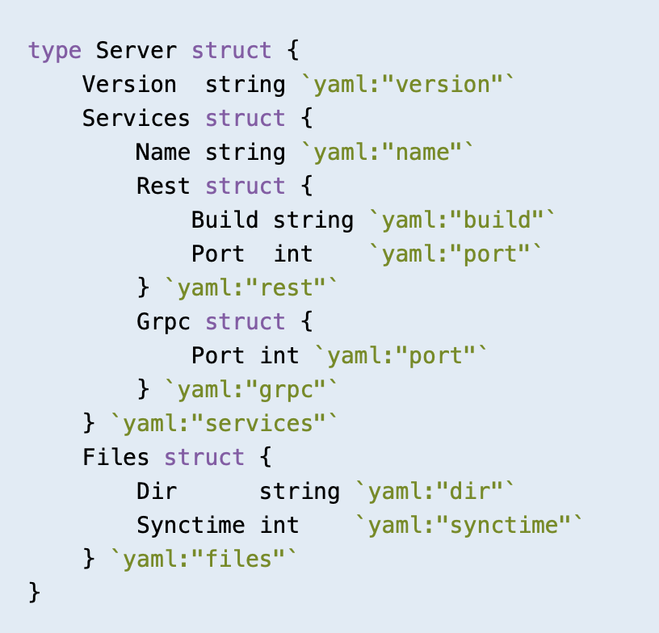
Server Configuration (server.config)
version: "1.0"
services:
name: "ATC Wire Transfer"
rest:
build: 09/12/2022
port: 8000
grpc:
port: 8000
files:
dir: "/directory"
synctime: 1000

Slide 21
Hint
Get → body contains no data. Can pass information using parameters
Post → Json Data passed "Content-Type” "application/json"

Slide 22
THANK YOU

